Slide 1

Computer Networks
Physical Layer

Slide 2
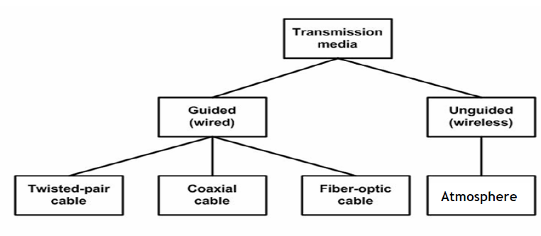
Transmission Terminology
Data transmission occurs between a transmitter & receiver via some medium
Guided medium
  eg. twisted pair, coaxial cable, optical fiber
Unguided / wireless medium
  eg. air, water, vacuum
Notes:
The first section presents some concepts and terms from the field of electrical engineering. This should provide sufficient background to deal with the remainder of the chapter. Data transmission occurs between transmitter and receiver over some transmission medium. Transmission media may be classified as guided or unguided. In both cases, communication is in the form of electromagnetic waves. With guided media, the waves are guided along a physical path; examples of guided media are twisted pair, coaxial cable, and optical fiber. Unguided media, also called wireless, provide a means for transmitting electromagnetic waves but do not guide them; examples are propagation through air, vacuum, and seawater.

Slide 3
Transmission Terminology
Direct link
  no intermediate devices
Point-to-point
  direct link
  only 2 devices share link
Multi-point
  more than two devices share the link
Notes:
The term direct link is used to refer to the transmission path between two devices in which signals propagate directly from transmitter to receiver with no intermediate devices, other than amplifiers or repeaters used to increase signal strength. A guided transmission medium is point to point if it provides a direct link between two devices and those are the only two devices sharing the medium. In a multipoint guided configuration, more than two devices share the same medium.

Slide 4
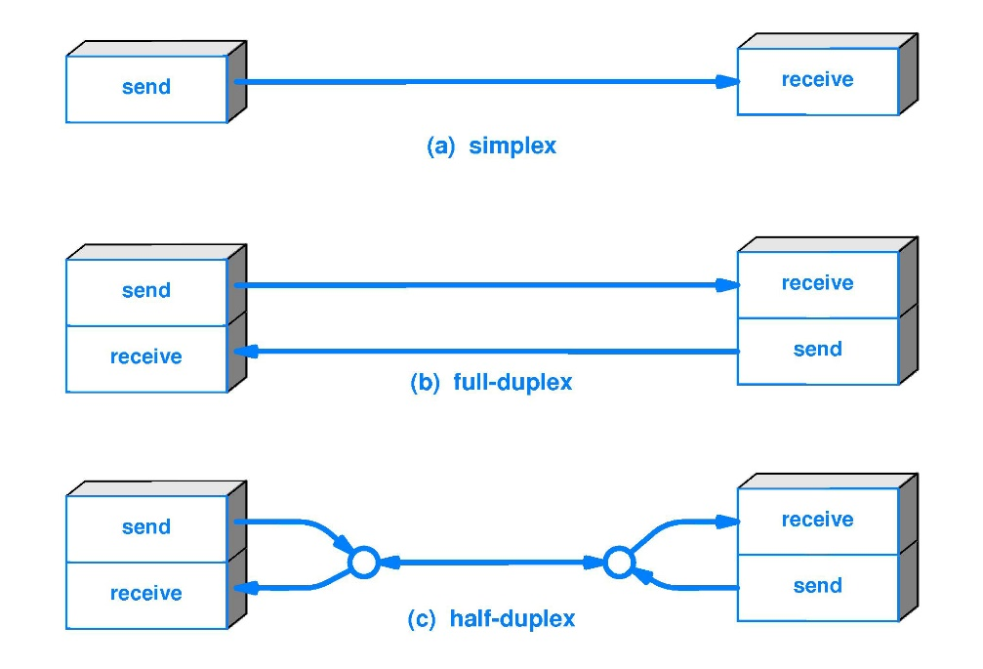
Transmission Terminology
Simplex
  one direction
    eg. television
Half duplex
  either direction, but only one way at a time
    eg. police radio
Full duplex
  both directions at the same time
    eg. telephone
Notes:
A transmission may be simplex, half duplex, or full duplex. In simplex transmission, signals are transmitted in only one direction; one station is transmitter and the other is receiver. In half-duplex operation, both stations may transmit, but only one at a time. In full-duplex operation, both stations may transmit simultaneously, and the medium is carrying signals in both directions at the same time.
We should note that the definitions just given are the ones in common use in the United States (ANSI definitions). Elsewhere (ITU-T definitions), the term simplex is used to correspond to half duplex and duplex is used to correspond to full duplex.

Slide 5
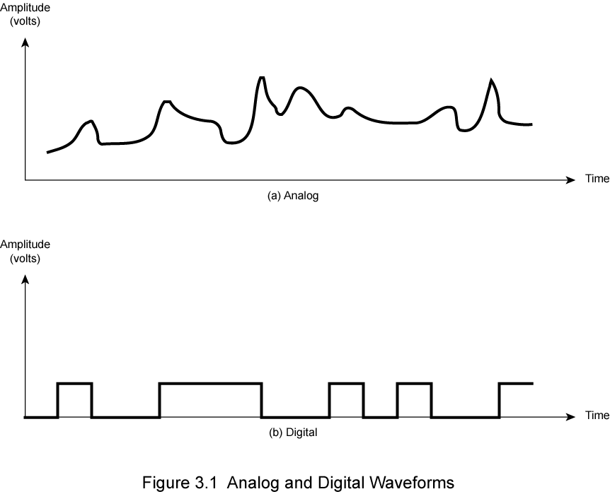
Frequency, Spectrum and Bandwidth
Time domain concepts
  Analog signal
    Varies in a smooth way over time
  Digital signal
    Maintains a constant level then changes to another constant level
  Periodic signal
    Pattern repeated over time
  Aperiodic signal
    Pattern not repeated over time
Notes:
In this book, we are concerned with electromagnetic signals used as a means to transmit data. The signal is a function of time, but it can also be expressed as a function of frequency; that is, the signal consists of components of different frequencies. It turns out that the frequency domain view of a signal is more important to an understanding of data transmission than a time domain view.
Viewed as a function of time, an electromagnetic signal can be either analog or digital. An analog signal is one in which the signal intensity varies in a smooth fashion over time. A digital signal is one in which the signal intensity maintains a constant level for some period of time and then abruptly changes to another constant level. This is an idealized definition. In fact, the transition from one voltage level to another will not be instantaneous, but there will be a small transition period.
The simplest sort of signal is a periodic signal, in which the same signal pattern repeats over time. Otherwise, a signal is aperiodic.

Slide 6
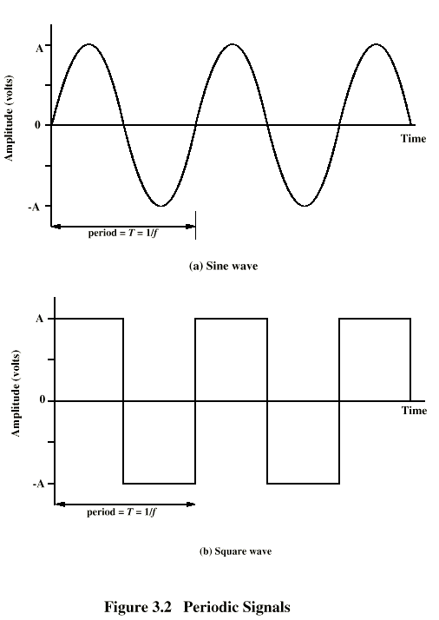
Periodic
Signals
Notes:
In Stallings DCC8e Figure 3.2 a signal is generated by the transmitter and transmitted over a medium. The signal is a function of time, but it can also be expressed as a function of frequency; that is, the signal consists of components of different frequencies. It turns out that the frequency domain view of a signal is more important to an understanding of data transmission than a time domain view. Both views are introduced here.

Slide 7
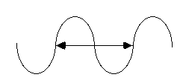
Wavelength, Period and Frequency
Arrow indicates one cycle of the signal.
Period(T) : The time it takes to complete a cycle
Frequency : Number of cycles per second
  Frequency=1/T
Frequency (f)
  Rate of change of signal
  Hertz (Hz) or cycles per second
  Period = time for one repetition (T)
  T = 1/f
  Wavelength : Distance occupied by one cycle.
  Amplitude : Value of the signal at different instants of time.
  Peak amplitude (A) : Maximum strength of signal
  Volts
Phase (φ)
  Relative position in time
http://www.procato.com/calculator-wavelength-frequency/

Slide 8
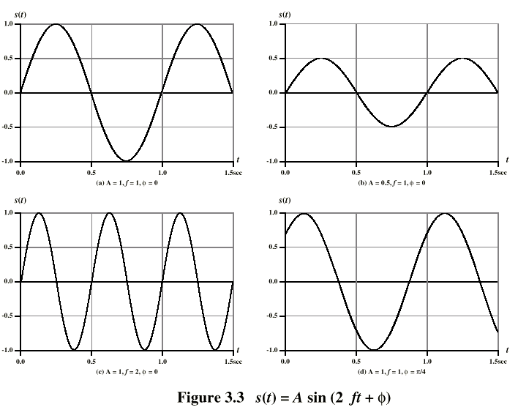
Varying Sine Waves s(t) = A sin(2πft +Φ)
Notes:
The general sine wave can be written as: s(t) = A sin(2πft + φ), known as a sinusoid function.
Stallings DCC8e Figure 3.3 shows the effect of varying each of the three parameters, the horizontal axis is time; the graphs display the value of a signal at a given point in space as a function of time. In part (a) of the figure, the frequency is 1 Hz; thus the period is T = 1 second. Part (b) has the same frequency and phase but a peak amplitude of 0.5. In part (c) we have f = 2, which is equivalent to T = 0.5. Finally, part (d) shows the effect of a phase shift of π/4 radians, which is 45 degrees (2π radians = 360˚ = 1 period).
These same graphs, with a change of scale, can apply with horizontal axes in space. In this case, the graphs display the value of a signal at a given point in time as a function of distance.

Slide 9
Frequency Domain Concepts
Signals are made up of many frequencies
Components are sine waves
Fourier analysis can show that any signal is made up of component sine waves
Can plot frequency domain functions
Notes:
In practice, an electromagnetic signal will be made up of many frequencies. It can be shown, using a discipline known as Fourier analysis, that any signal is made up of components at various frequencies, in which each component is a sinusoid. By adding together enough sinusoidal signals, each with the appropriate amplitude, frequency, and phase, any electromagnetic signal can be constructed.

Slide 10
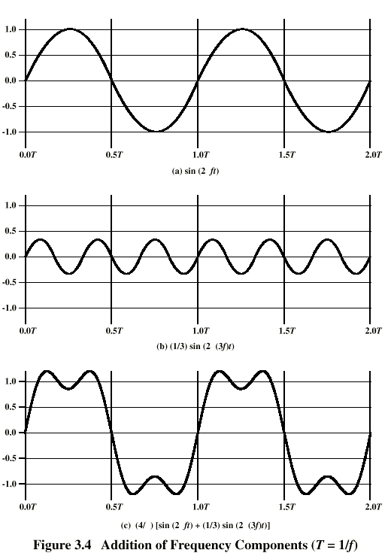
Addition of
Frequency
Components
(T=1/f)
π
c is sum of f & 3f
π
π
π
π
Notes:
In Stallings DCC8e Figure 3.4c, the components of this signal are just sine waves of frequencies f and 3f, as shpwn in parts (a) and (b).

Slide 11
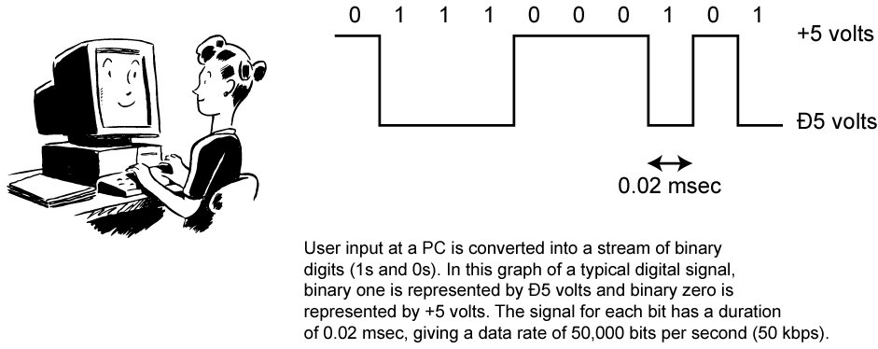
Digital Data
As generated by computers etc.
Achievable Bandwidth depend on data rate.
Notes:
Lastly consider binary data, as generated by terminals, computers, and other data processing equipment and then converted into digital voltage pulses for transmission. This is illustrated in Stallings DCC8e Figure 3.13. A commonly used signal for such data uses two constant (dc) voltage levels, one level for binary 1 and one level for binary 0. Consider the bandwidth of such a signal, which depends on the exact shape of the waveform and the sequence of 1s and 0s. The greater the bandwidth of the signal, the more faithfully it approximates a digital pulse stream.

Slide 12
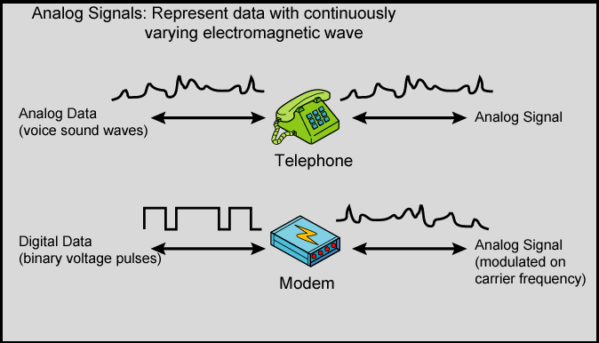
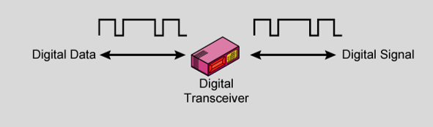
Analog and Digital Signals
Notes:
In a communications system, data are propagated from one point to another by means of electromagnetic signals. Both analog and digital signals may be transmitted on suitable transmission media.
An analog signal is a continuously varying electromagnetic wave that may be propagated over a variety of media, depending on spectrum; examples are wire media, such as twisted pair and coaxial cable; fiber optic cable; and unguided media, such as atmosphere or space propagation.
As Stallings DCC8e Figure 3.14 illustrates, analog signals can be used to transmit both analog data represented by an electromagnetic signal occupying the same spectrum, and digital data using a modem (modulator/demodulator) to modulate the digital data on some carrier frequency.
However, analog signal will become weaker (attenuate) after a certain distance. To achieve longer distances, the analog transmission system includes amplifiers that boost the energy in the signal. Unfortunately, the amplifier also boosts the noise components. With amplifiers cascaded to achieve long distances, the signal becomes more and more distorted. For analog data, such as voice, quite a bit of distortion can be tolerated and the data remain intelligible. However, for digital data, cascaded amplifiers will introduce errors.

Slide 13
Transmission media
Magnetic media
  Tapes, diskettes
  Supports very high data rate (high bandwidth)
  A 8 mm tape = 7 GB ➔ A 50*50*50 Cm box = 1000 tapes =7000 GB
  7000GB/24 Hrs= 648 Mbps 7000GB/1Hr=15Gbps
  Sometimes it's cheaper and faster to load a box of tapes in your car!
  Problem: Delay !
Twisted pair (1)
  Simply two wires twisted together – thickness=1mm
  The twisting cuts down on electrical interference.
  Heavily used in the phone system
  Typical office has four pairs for phones.
  Until some Kilometers/ Some Mbps
  For Analog and Digital

Slide 14
Transmission media (2)
Twisted pair (2)
  Bandwidth depends on thickness and distance
  Need repeater for long distances
  Category 3 and 5 - with 5 having more twists and better insulation.
  Popular by UTP (Unshielded Twisted Pair)
  Cat3 Cat 5
  UTP = Unshielded Twisted Pair
    Cat 3: Home telephone lines
    Cat 5: Fast Ethernet (100 Mbps)
    Cat 5e: Gigabit Ethernet (1 Gbps)
    Cat 6: 10-Gigabit Ethernet (10 Gps) up to 100 m
    Cat 6A: Better quality Cat 6
    Cat 7: Includes shielding (not in common use)

Slide 15
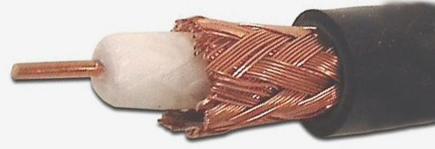
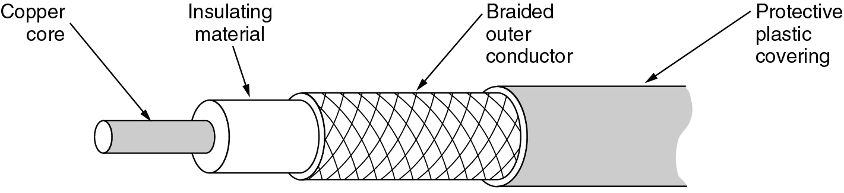
Transmission Media (3)
Baseband Coaxial cable
  Used for digital transmissions (called baseband)
  Works only with half-duplex.
  Mostly used in LAN(steady drop after 0.62 miles)
  Data rates is 10 Mbps for 1 Km distance.
  Low cost(No need modems) and easy to use.
  Now being replaced by fiber.
Broadband Coaxial cable
  Used for analog transmissions (called broadband.)
  Use 300 MHz for long distances using Frequency Multiplexing(FDM)
  Operates at distances up to 100 km (metropolitan area!)
  Interfaces must convert digital signals to analog and vice versa.
  Designed for long distances - can use amplifiers.

Slide 16
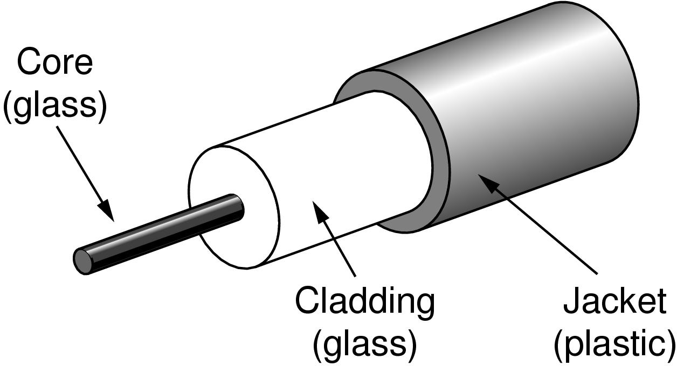
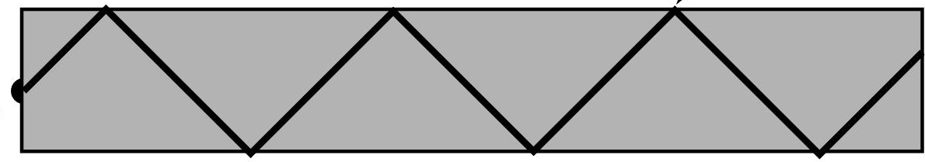


Transmission Media (4)
Fiber Optic (1)
  Transmission of light through fiber.
  Fiber medium: Current technology carries light pulses for tremendous distances (e.g., 100s of kilometres) with virtually no signal loss.
  Light source: typically a Light Emitting Diode (LED) or laser diode. Running current through the material generates a pulse of light.
  A photo diode light detector, which converts light pulses into electrical signals.
  Including 3 components:
    Light source: Pulse of light=1, absence of light=0
    Transition medium: an ultra-thin fiber of glass
    detector: generate an electrical pulse when light falls on it
Light source (LED, laser)
Light trapped by total internal reflection
Photodetector

Slide 17
Transmission Media (4)
Advantages of Fiber optics:
  Very high data rate(response time=1ns, data rate = 1 Gbps ).
  Very low error rate(almost negligible).
  Much thinner than existing copper wires
  Not susceptible to electrical interference (lightning) or corrosion (rust).
  Greater repeater distance than coax.
Comparison of fiber optic and copper wire
 | Fiber | Copper
Bandwidth | Higher | Lower
Distance between repeaters | 30 KM | 5 Km
Interference | Low | High
Cost | High | Low
Flow | Uni-directional | Bi-directional

Slide 18
Wireless transmission
Radio transmission
Microwave Transmission
Lightwave Transmission
Satellites

Slide 19
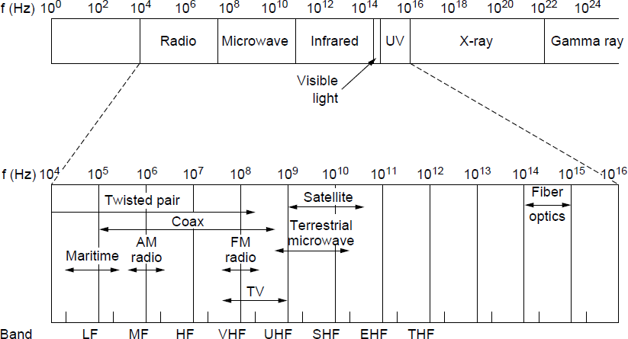
Electromagnetic Spectrum (1)
Different bands have different uses:
Microwave: LANs and 3G/4G;
Networking focus
Microwave

Slide 20
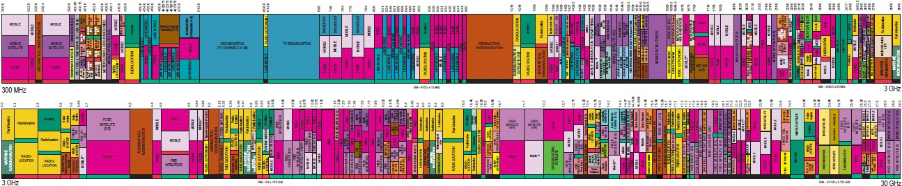

Electromagnetic Spectrum (2)
To manage interference, spectrum is carefully divided, and its use regulated and licensed, e.g., sold at auction.
300 MHz
3 GHz
WiFi (ISM bands)
3 GHz
Source: NTIA Office of Spectrum Management, 2003
30 GHz
Part of the US frequency allocations

Slide 21
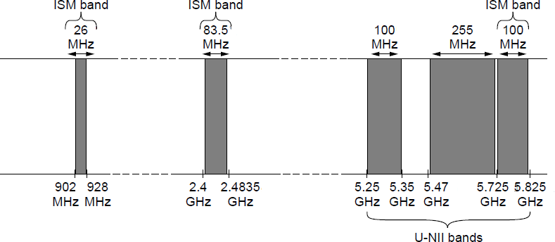
Electromagnetic Spectrum (3)
Fortunately, there are also unlicensed (“ISM”) bands:
Free for use at low power; devices manage interference
Widely used for networking; WiFi, Bluetooth, etc.
802.11
b/g/n
802.11a/g/n/ac

Slide 22
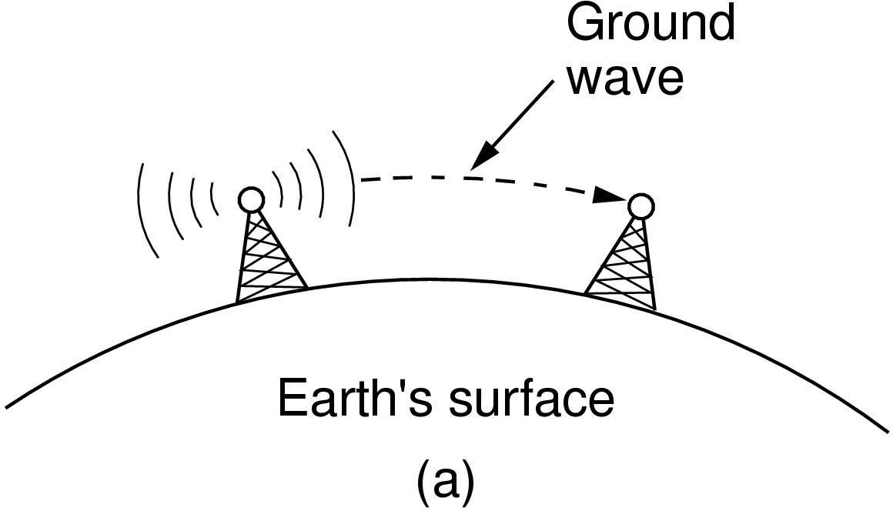
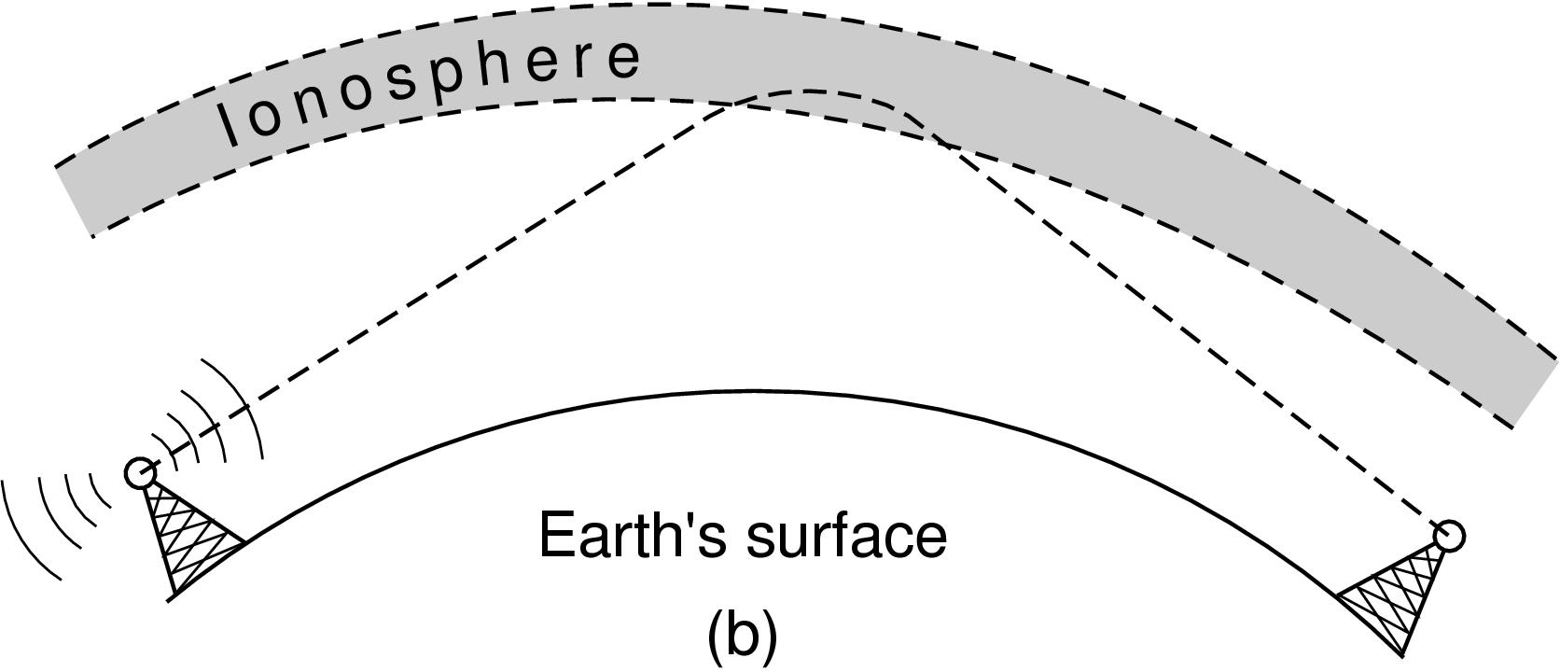
Radio Transmission
Radio signals penetrate buildings well and propagate for long distances with path loss
In the VLF, LF, and MF bands, radio waves follow the curvature of the earth
In the HF,UHF band, radio waves bounce off the ionosphere.
Ionosphere : The layer of the earth's atmosphere which contains a high concentration of ions and free electrons and is able to reflect radio waves. It lies above the mesosphere and extends from about 80 to 1,000 km above the earth's surface.
https://en.wikipedia.org/wiki/Radio_spectrum

Slide 23
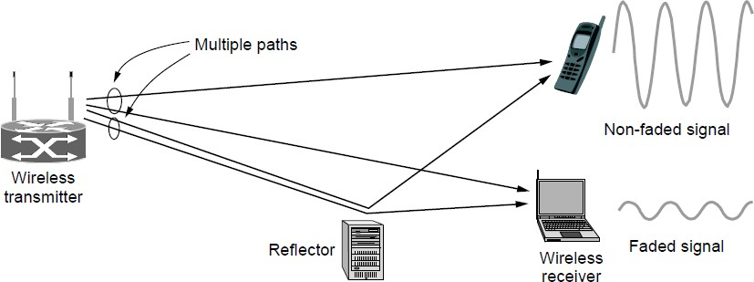
Microwave Transmission
Microwaves have much bandwidth and are widely used indoors (WiFi) and outdoors (3G, satellites)
Signal is attenuated/reflected by everyday objects
Strength varies with mobility due multipath fading, etc.

Slide 24
Communication Satellites
Satellites are effective for broadcast distribution and anywhere/anytime communications
Kinds of Satellites
  Geostationary (GEO) Satellites
  Low-Earth Orbit (LEO) Satellites

Slide 25
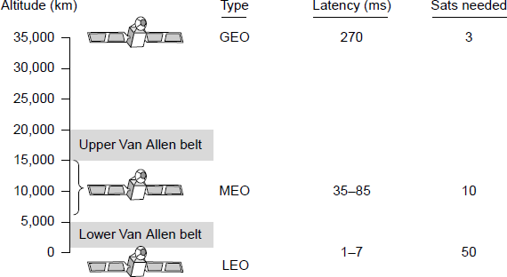
Kinds of Satellites
Satellites and their properties vary by altitude:
Geostationary (GEO), Medium-Earth Orbit (MEO), and Low-Earth Orbit (LEO)
Sats needed for global coverage

